Slide 1

Examples of Teaching Activities for Using and Producing

Slide 2
Dw i’n clywed, dw i’n dweud: How to play
Learners work in pairs to complete this version of a loop game.
2. Partner 1 starts at ‘Dechrau’ and uses the picture next to it to say the sentence (in the example slide: ‘Mae bola tost gyda fi.’)
2. Partner 2 listens to Partner 1, and they find the same sentence (‘Mae bola tost gyda fi’) in their printed sentences.
3. Partner 2 then use the picture next to this sentence to say their next sentence, for Partner 1 to listen (‘Mae cefn tost gyda fi’).
4. They continue taking turns like this until Partner 2 reaches ‘Y diwedd’.

Slide 3


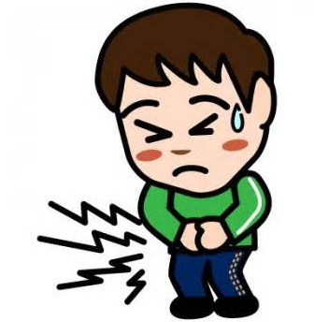
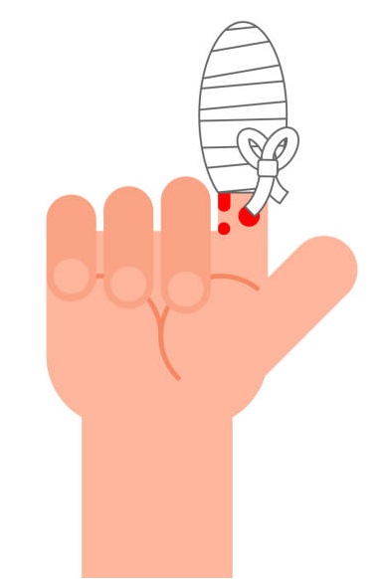

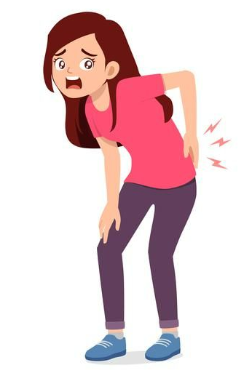



Dw i’n clywed, dw i’n dweud! (1)
Partner 1:
Partner 2:
Dechrau
Mae clust dost gyda fi
Mae bys tost gyda fi.
Mae cefn tost gyda fi.
Mae penelin tost gyda fi.
Mae bola tost gyda fi.
Mae llwnc tost gyda fi.
Mae pen tost gyda fi. | Y diwedd

Slide 4


Dw i’n clywed, dw i’n dweud! (2)
Partner 1:
Partner 2:
Dechrau
Mae clust dost gyda fi
Does dim bys tost gyda fi.
Does dim cefn tost gyda fi.
Mae penelin tost gyda fi.
Does dim bola tost gyda fi.
Mae llwnc tost gyda fi.
Does dim pen tost gyda fi. | Y diwedd

Slide 5
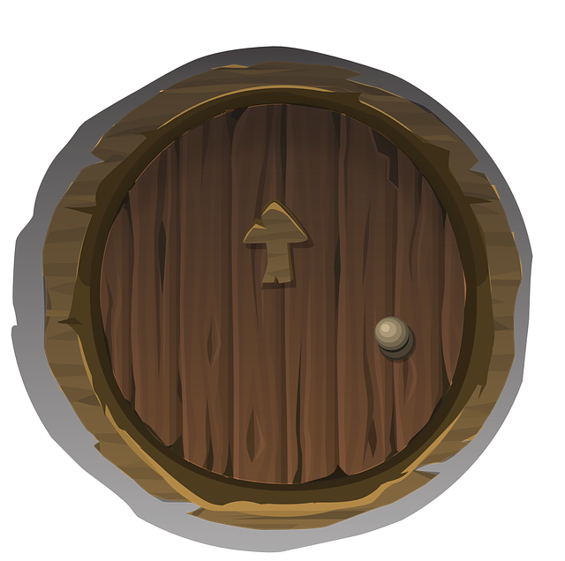
Trapdoor: How to play
Partner A secretly writes down a path through the sequence of sentences.
They make one choice per box, for example: 1a, 2a, 3c, 4a.
Partner B tries to guess Partner A’s choice for box 1 and reads the sentence out loud.
If Partner B guesses box 1 correctly, they can move on to guessing box 2.
If Partner B guesses box 1 incorrectly, they must start again from the beginning.
It is important that they go all the way back to the beginning whenever they make a wrong guess.
This continues until Partner A has guessed all sentences correctly. Then they swap roles.

Slide 6

Trapdoor 1
1a Mae pen tost gyda fi.
1b Mae bola tost gyda fi.
2a Does dim cefn tost gyda fi.
2b Does dim llwnc tost gyda fi.
4a Mae bys tost gyda fi.
4b Mae clust dost gyda fi.
3a Does dim penelin tost gyda fi.
3b Does dim pen tost gyda fi.

Slide 7
Trapdoor 2
1a Fy enw i ydy Fflic.
1b Fy enw i ydy Fflac.
1c Fy enw i ydy Sam.
2a Dw i’n byw yn Y Barri.
2b Dw i’n byw yn Rhws.
2c Dw i’n byw yn Sili.
4a Mae brawd gyda fi o’r enw Sam.
4b Mae chwaer gyda fi o’r enw Ffion.
4c Does dim brawd neu chwaer gyda fi.
3a Dw i’n saith oed.
3b Dw i’n wyth oed.
3c Dw i’n naw oed.

Slide 8

Sentence Chaos: How to play
1. Partner A secretly writes two numbers between 1 and 9 on their mini- whiteboard.​ They then read the two corresponding sentences in the same order.​
​
2. Partner B has to repeat the sentences in the same order. If they get it wrong, Partner A repeats the sentences in the correct order and Partner B tries again.
​
3. Learners can increase the number of sentences if they want to raise
the challenge.

Slide 9
Sentence chaos
Beth sy’n bod?
Mae pen tost gyda fi.
Does dim pen tost gyda fi.
Mae cefn tost gyda fi.
Does dim cefn tost gyda fi.
Mae clust dost gyda fi.
Does dim clust dost gyda fi.
Mae llwnc tost gyda fi.
Does dim penelin tost gyda fi.

Slide 10

Lie detector: How to play
Partner A and Partner B take turns.​
​
Partner A starts by secretly choosing a sentence from the board.​
Partner A secretly writes down the number of this sentence. ​
​
Partner A now has two choices:​
Tell the truth and read the sentence for the number they wrote down to Partner B.​
Lie and read another sentence to Partner B, with a number different to the one they wrote down.
​
Partner B has to guess if Partner A said the truth, or if they lied. Then they swap roles.​
​
Scoring:
Keep a tally for each player.​
1 point for guessing a lie or truth correctly​
1 point when your opponent guesses incorrectly

Slide 11
Lie detector
Beth sy’n bod?
Mae pen tost gyda fi.
Does dim pen tost gyda fi.
Mae cefn tost gyda fi.
Does dim cefn tost gyda fi.
Mae clust dost gyda fi.
Does dim clust dost gyda fi.
Mae llwnc tost gyda fi.
Does dim penelin tost gyda fi.

